Slide 1
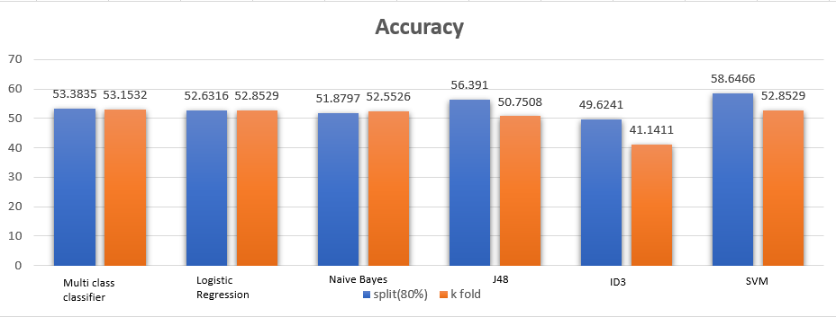
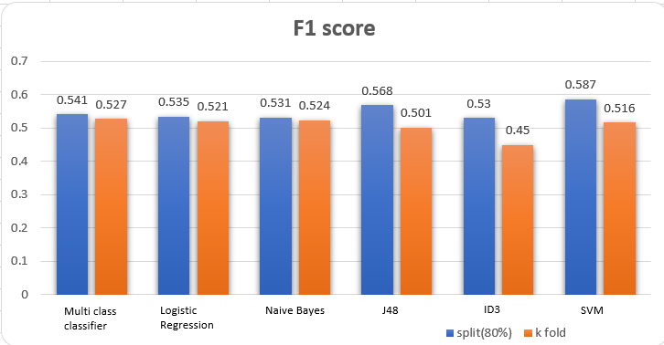
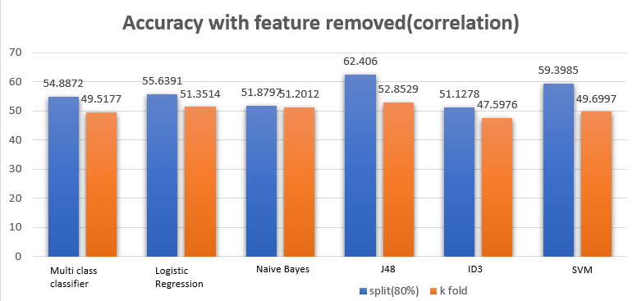
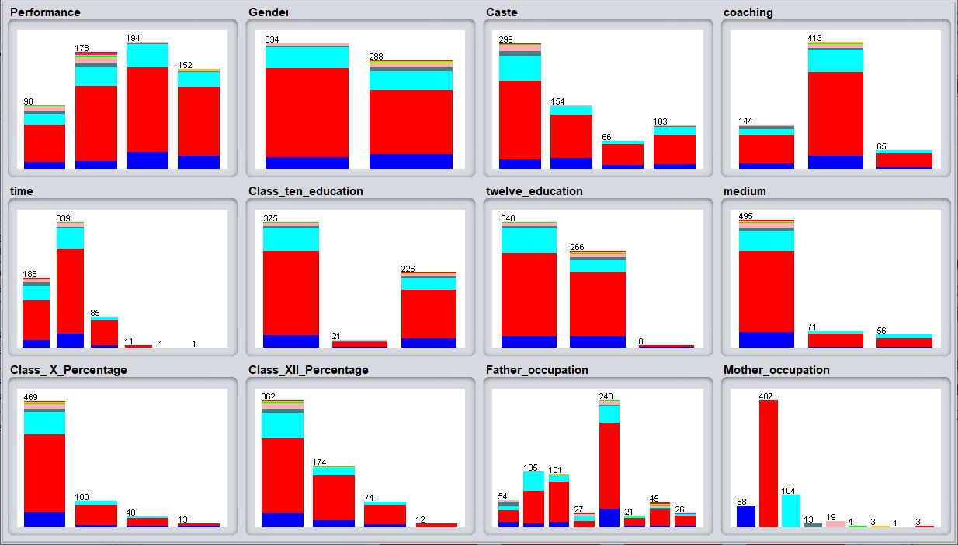
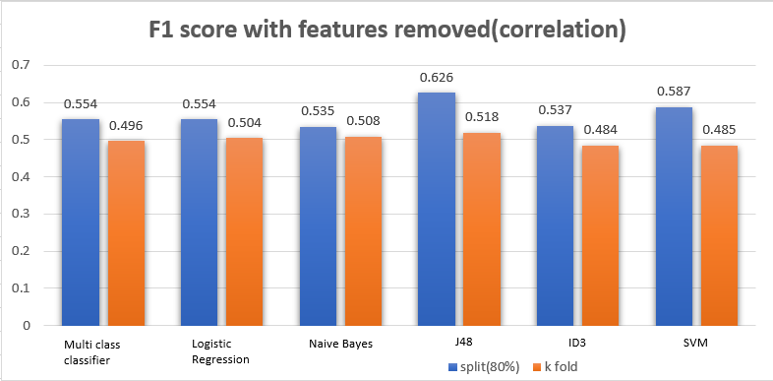
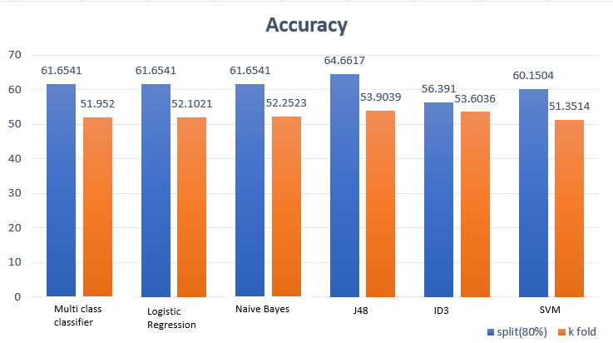
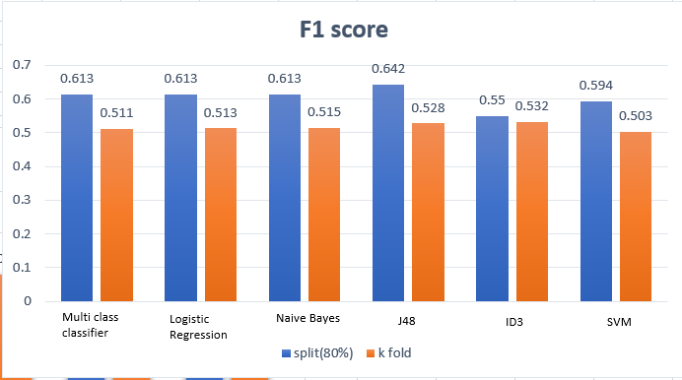

Analysis of Student Performance
Yoshith Harshana, Kalani Prabodha, Nimashi Uthpala
Department of Computer Engineering,University of Peradeniya
Abstract
Methodology
Results
The object of this is to analyze and evaluate the university students performance of the common entrance examination(CEE), who qualified the medical entrance examination for admission to a medical college by applying different data mining and classification techniques by using WEKA tool. The highest accuracy of classifier algorithm depends on the size and the nature of the data.
The dataset is partitioned as training (80%) and testing(20%) dataset and the classifiers are trained by using 5 fold cross validation and data split set. The correctness of the classifier is tested using test dataset.
DATA PREPROCESSING
The pre - processing is an important step that is used to extract and improve the quality of data. There are no null values in the data set. Therefore as preprocessing dropping duplicate values and correlation is done.
Without removing any attributes
Removed some attributes by looking at correlations
Introduction
Educational data mining (EDM) is a very important research area which helpful to predict useful information from educational database to improve educational performance, better understanding and to have better assessment of the students learning process.
Research on that will be helped to the students and the teachers to improve the result of the students who are at the risk of failure.
Data Preprocessor output
Using best results giving attribute set
Looking at the correlation(Pearson's) of the attributes with performance, some attributes are removed with the threshold of 0.05. Selected attributes are caste, class_x_perecentage, class_xi_perecentage,coaching, class_ten_education.
Problem Description
DATA SET
The dataset contains data of the candidates who qualified the medical entrance examination for admission to medical colleges of Assam of a particular year and collected by Prof. Jiten Hazarika.
Provided by : Dr. Sadiq Hussain, Dibrugarh University, sadiq '@' dibru.ac.in
Repository: https://archive.ics.uci.edu/ml/datasets/Student+Performance+on+an+entrance+examination
Number of instances : 666
Number of attributes : 12
All the data in the dataset are categorical and no null value can be observed.
Discussion and conclusion
References
https://bit.ly/2YH7z7c
https://bit.ly/3oVlEsx
As the next step some other features are dropped by doing learner based feature selection.Caste,coaching and class_ten_eduaction are selected from it.
Decision tree classifier(J48) gives the best performance among other classifiers.Based on our findings caste, coaching and class ten education makes the most effect on the performance in the entrance exam. Reason for the less accuracy might be the number of classes to be classified, the probability to be misclassified might high with the increasing number of classes.Expanding the dataset and working more on data preprocessing might improve the model in future.
MODEL EVALUATION
For model training 6 major algorithms are used.
Multiclass classifier
Naive Bayes
Logistic Regression
ID3
J48
SVM
For evaluation accuracy and F1 score are used.

